Slide 1
Applying Models

Slide 2
Contents
Modelling systems
01
Evaluating case studies
02
Finding similarities in data
03
Creating predictions
04

Slide 3
Applying Models

Slide 4
Goal
Understanding models
1
Categorizing models
2
Introducing the benefits of models
3
Highlighting relevant case studies
4

Slide 5
Modelling Data
Most predictive analytics tools come equipped with common algorithms, the underlying mathematical formulas, to help you build your model.
Building a model is part science and part art.
The science refers to well-established statistical techniques, machine learning, and data-mining algorithms.
Tweaking is the art.
Notes:
A completed
model can be applied in a few minutes. In fact, a business
analyst
with no specific background in statistics, data mining, or machine
learning can run powerful algorithms on the data relatively quickly, using
available predictive analytics tools.

Slide 6

Models and simulation
The standard approach is to run what-if scenarios — hypothetical situations that your simulations investigate.
The general outline of running a what-if scenario looks like this:
Build the model.
Start changing the values of parameters and examining the new results or use a tool — a specialized software program that automates that whole process for you.
Look at the report that the model generates.
Evaluate the result and pick the most important predictors; if you’ve run multiple models, pick the right model.

Slide 7
Categorizing models
Various ways to categorize the models used for predictive analytics.
The business problems they solve and the primary business functions
The mathematical implementation used in the model (such as statistics, data mining, and machine learning).
The intended function of the model—
Predictive
Classification
Clustering
decision-oriented
Associative
Notes:
The business problems they solve and the primary business functions they serve (such as sales, advertising, human resources, or risk
management).

Slide 8
Predictive models
Predictive models analyse data and predict the next outcome.
This is the big contribution of predictive analytics, as distinct from business intelligence.
Business intelligence monitors what’s going on in an organization now.
Predictive models analyse historical data to make an informed decision about the likelihood of future outcomes.
Given certain conditions (recent number and frequency of customers complaints, the date of renewal of service approaching, and the availability of cheaper options by the competition) how likely is this customer to churn?
The output of the predictive model can also be a binary, yes/no or 0/1 answer:
whether a transaction is fraudulent,
for example. A predictive model can generate multiple results, sometimes combining yes/no results with a probability that a certain event will happen.
A customer’s creditworthiness,
for example, could be rated as yes or no, and a probability assigned that describes how likely that customer is to pay off a loan on time.

Slide 9
Clustering and classification models
When a model uses clustering and classification, it identifies different groupings within existing data.
You can still build a predictive model on top of the output of your clustering model using the clustering to classify new data points.
If, for example, you run a clustering algorithm on your customers’ data and thereby separate them into well-defined groups, you can then use classification to learn about a new customer and clearly identify his group.
Then you can tailor your response
for example, a targeted marketing campaign and your handling of the new customer.
Classification uses a combination of characteristics and features to indicate whether an item of data belongs to a particular class.
Many applications or business problems can be formulated as classification problems.
For example, you can classify outcomes as desired and undesired.
For instance, you can classify an insurance claim aslegitimate or fraudulent.

Slide 10
Decision models
Given a complex scenario, what is the best decision to make — and if you were to take that action, what would the outcome be?
Decision-oriented models (simply called decision models) address such questions by building strategic plans so as to identify the best course of action, given certain events.
Decision models can be risk mitigations strategies, helping to identify your best response to unlikely events.
Decision models probe various scenarios and select the best of all courses.
To make an informed decision, you need deep understanding of the complex relationships in the data and the context you’re operating in.
A decision model serves as a tool to help you develop that understanding.

Slide 11
Association models
Associative models (called association models) are built on the underlying associations and relationships present in the data.
If (for example) a customer is subscribed to a particular service, it’s most likely that she will order another specific service.
If a customer is looking to buy Product A (a sports car), and that product is associated with Product B (say, sunglasses branded by the carmaker), he is more likely to buy Product B.
Some of these associations can easily be identified; others may not be so obvious.
Stumbling over an interesting association, previously unknown, can lead to dramatic benefits.
Another way of finding an association is to determine whether a given event increases the probability that another event will take place.
For example, a company that leads a certain industrial sector just reported stellar earnings,
what is the probability that a basket of stocks in that same sector to go up in value?

Slide 12
Describing and summarizing data
Describing your data can provide a precise summary of the characteristics and underlying structure that make the data relevant and useful.
For example, identifying different groupings within the data is an essential step toward building a model that accurately represents your data — which makes a useful analytical result more likely.

Slide 13
Making better business decisions
Business leaders use predictive analytics, to empower business decision-making.
The value of data to an organization is- how well it drives decision-making toward the organization’s success.
Data-driven decisions give your business and managerial processes a solid footing, enhance your customers’ satisfaction, and increase your return on investment.
In a world marketplace full of ever-changing variables governed by complex rules and immensely interdependent global systems
organizations can navigate more successfully by using predictive analytics to replace guesswork with actions based on real data.
Predictive analytics can transform your business by generating useful new insights that can serve as the basis of sound strategies and effective decision- making based on facts.

Slide 14
Healthcare Analytics Case Studies
Google search queries as epidemic predictors
Cancer survivability predictors

Slide 15
Social and Marketing Analytics Case Studies
Tweets as predictors for the stock market
Target store predicts pregnant women
Twitter-based predictors of earthquakes
Twitter-based predictors of political campaign outcomes

Slide 16

Identifying Similarities in Data

Slide 17
GOAL
Clustering data
Identifying hidden groups of similar information in your data
Finding associations among data items
Organizing data with biologically inspired clustering

Slide 18
Data clustering
Helps you to make sense in flood of data by discovering hidden groupings of similar data items.
Provides a description of your data , data contains x number of groups of similar data objects.
For example, when you store groceries in your fridge, you group the vegetables by themselves in the crisper, put frozen foods in their own section (the freezer), so on.
When you organize currency in your wallet, you arrange the bills by denomination — larger with larger, smaller with smaller.
Clustering algorithms achieve this kind of order on a large scale for businesses or organizations — where datasets can comprise thousands or millions of data records associated with thousands of customers, suppliers, business partners, products, services, and so on.

Slide 19
Data Clustering
Data clustering is the task of dividing a dataset into subsets of similar items.
Items can also be referred to as instances, observation, entities or data objects.
Adataset is represented in table format — a data matrix.
A data matrix is a table of numbers, documents, or expressions, represented in rows and columns as follows:
Each row corresponds to a given item in the dataset.
Rows are sometimes referred to as items, objects, instances, or observations.
Each column represents a particular characteristic of an item.
Columns are referred to as features or attributes.

Slide 20
Data Clustering
Similar items have a strong, measurable relationship among them.
The strength of a relationship between two or more items can be quantified as a similarity measure
A mathematical function computes the correlation between two data items.
The results of that computation, called similarity values.
Those other items will be either more similar or less similar in comparison to that specific item.
Computed similarities play a major role in assigning items to groups (clusters).
Each group has an item that best represents it; this item is referred to as a cluster representative.

Slide 21
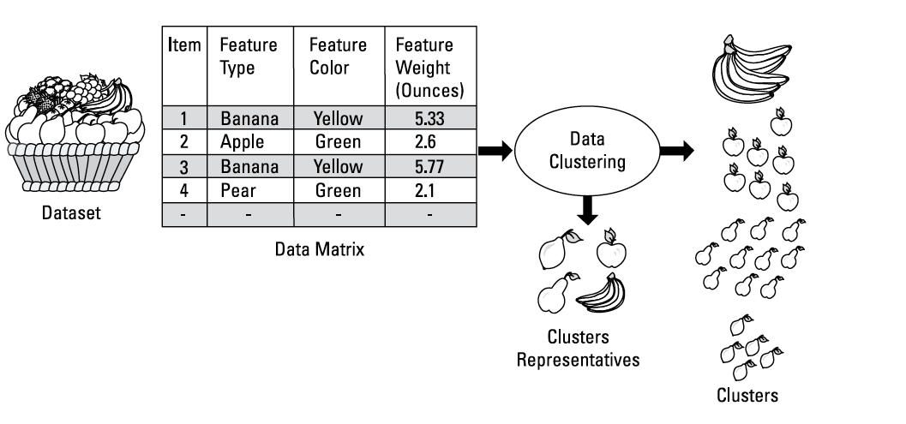
Explaining Data Clustering

Slide 22
Example
Applying a data clustering technique to the fruit dataset as described above allows you to Retrieve groups (clusters) of similar items.
fruit is of N number of groups.
After that, if you pick a random fruit, you will be able to make a statement about that item as being part of one of the N groups.
Retrieve cluster representatives of each group.
In this example, a cluster representative would be picking one fruit type from the basket and putting it aside.
The characteristics of this fruit are such that fruit best represents the cluster it belongs to.

Slide 23
Data clustering usage
Medicine:
Applying data clustering to a matrix of gene expression (often known as microarray gene expression data) from different cancer-diagnosed patients
It can generate clusters of positively and negatively diagnosed cancer patients, which can help predict the nature of new cases.
Marketing:
Using data clustering to group customers according to similar purchase behaviour improves the efficiency of targeted marketing.
Law enforcement:
In social network analysis, the same data-clustering techniques that can help detect communities of common interests can also help identify online groups involved in suspicious activity.

Slide 24
Data clustering usage
Computer imaging:
Data clustering is part of image segmentation — the process of dividing a digital image into multiple segments in order to analyse the image more easily.
Applying data clustering to an image generates segments (clusters) of contours that represent objects — aiding the detection of threatening health conditions in medical diagnosis and in the screening of airport baggage for suspicious materials.
Information retrieval:
Here the aim is to search and retrieve information from a collection of data, for instance a set of documents.
Dividing a collection of documents into groups of similar documents is an essential task in information retrieval.

Slide 25

Converting Raw Data into a Matrix
representing data in a tabular format known as a data matrix

Slide 26
Creating a matrix of terms in documents
Data Representation - A Crucial Step
Before extracting groups of similar data items from a dataset, it's essential to represent your data in a suitable format.
This pre-processing step comes before the actual data clustering.
Document-to-Data Matrix Conversion
Imagine your dataset is a set of Microsoft Word documents.
The first task is to convert these documents into a data matrix.
Several tools, both commercial and open-source, can help with this, producing what's known as a document-term matrix.
Examples of such tools include RapidMiner and R text-mining packages like tm.
Understanding Document-to-Data Matrix Conversion
A document is essentially a collection of words, and a term can be a single word or a combination of words.
Each term in a document has a frequency value called term frequency (TF), indicating how many times it appears in the document.
Notes:
n this lecture, we will explore the essential preprocessing step of converting data into a data matrix before performing data clustering.
Specifically, we'll discuss how to create a matrix of terms in documents, a crucial step in preparing your data for clustering analysis.
Slide 2: Data Representation - A Crucial Step
Before extracting groups of similar data items from a dataset, it's essential to represent your data in a suitable format.
This preprocessing step comes before the actual data clustering.
Slide 3: Document-to-Data Matrix Conversion
Imagine your dataset is a set of Microsoft Word documents. The first task is to convert these documents into a data matrix.
Several tools, both commercial and open-source, can help with this, producing what's known as a document-term matrix.
Examples of such tools include RapidMiner and R text-mining packages like tm.
Slide 4: Understanding Document-to-Data Matrix Conversion
Let's dive into how documents are converted into a data matrix.
A document is essentially a collection of words, and a term can be a single word or a combination of words.
Each term in a document has a frequency value called term frequency (TF), indicating how many times it appears in the document.

Slide 27
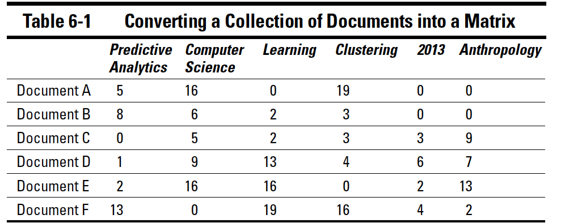
Creating a matrix of terms in documents
The terms that appear in all documents are listed across the top row.
Document titles are listed down the leftmost column
The numbers that appear inside the matrix cells correspond to each term’s frequency.
For instance, in Table 6-1, Document A is represented as set of numbers (5,16,0,19,0,0.) where 5 corresponds to the number of times the term predictive analytics is repeated, 16 corresponds to the number to times computer science is repeated, and so on.
Notes:
Slide 5: Constructing the Data Matrix
The process of constructing the matrix of terms in documents is as follows:
The terms that appear in all documents are listed across the top row.
Document titles are listed down the leftmost column.
The numbers inside the matrix cells represent the term frequencies.
Slide 6: Example - Constructing a Data Matrix
Let's illustrate this with an example.
Consider Table 6-1, where Document A is represented as a set of numbers (5, 16, 0, 19, 0, 0).
Here, 5 corresponds to the frequency of the term "predictive analytics," and 16 corresponds to the frequency of "computer science" in Document A.
This straightforward representation helps convert a set of documents into a matrix.
Slide 7: Significance of Data Matrix
The data matrix serves as the foundation for data clustering.
It provides a structured format that clustering algorithms can work with.
The term frequencies capture the importance of each term within each document.
Slide 8: Conclusion
In summary, creating a data matrix, especially when dealing with text data, is a crucial preprocessing step before performing data clustering.
This matrix of terms in documents helps structure the data and prepares it for clustering analysis.

Slide 28
Term selection
One challenge in clustering text documents is determining how to select the best terms to represent all documents in the collection.
How important a term is in a collection of documents can be calculated in different ways.
If, for example, you count the number of times a term is repeated in a document and compare that total with how often it recurs in the whole collection, you get a sense of the term’s importance relative to other terms.
Basing the relative importance of a term on its frequency in a collection is often known as weighting.

Slide 29
Term selection
The weight you assign can be based on two principles:
Terms that appear several times in a document are favoured over terms that appear only once.
Terms that are used in relatively few documents are favoured over terms that are mentioned in all documents.
If (for example) the term century is mentioned in all documents in your dataset, then you might not consider assigning it enough weight to have a column of its own in the matrix.
Similarly, if you’re dealing with a dataset of users of an online social network, you can easily convert that dataset into a matrix.
User IDs or names will occupy the rows; the columns will list features that best describe those users.

Slide 30
Identifying K-Groups in Your Data
An algorithms used in data clustering, K-means, is named after the algorithm’s input and output:
K is an input to the algorithm
it stands for the number of groupings that the algorithm must extract from a dataset, expressed algebraically as k. means are outputs of the algorithm
they refer to the set of representatives that represent k clusters.
A cluster representative is the statistical mean of all the data items in the same cluster.

Slide 31
K-means clustering algorithm
A K-means algorithm divides a given dataset into k clusters.
The algorithm performs the following operations:
Pick k random items from the dataset and label them as cluster representatives.
Associate each remaining item in the dataset with the nearest cluster representative, using a Euclidean distance calculated by a similarity function.
Recalculate the new clusters’ representatives.
Repeat Steps 2 and 3 until the clusters do not change.

Slide 32
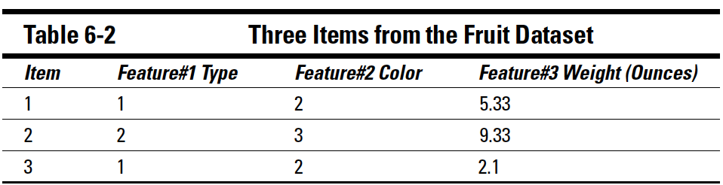
K-means clustering algorithm
A representative of a cluster is the mathematical mean (average) of all items that belong to the same cluster.
This representative is also called a cluster centroid.
For instance, consider three items from the fruit's dataset where
Type 1 corresponds to bananas.
Type 2 corresponds to apples.
Color 2 corresponds to yellow.
Color 3 corresponds to green.
Assuming that these items are assigned to the same cluster, the centroid of these three items is calculated as shown in Table 6-2.

Slide 33
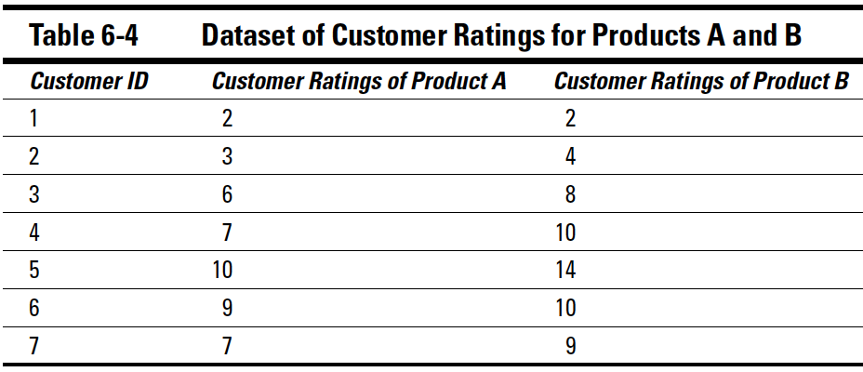
Example
The dataset shown in Table 6-4 consists of seven customers’ ratings of two products, A and B.
The ranking represents the number of points (between 0 and 10) that each customer has given to a product
the more points given, the higher the product is ranked.
Using a K-means algorithm and assuming that k is equal to 2, the dataset will be partitioned into two groups.

Slide 34
1. Pick two random items from the dataset and label them as cluster representatives
Table 6-4 shows the initial step of selecting random centroids from which the K-means clustering process begins.
The initial centroids are selected randomly from the data that you are about to analyse.
looking for two clusters, so two data items are randomly selected: Customers 1 and 5.
At first, the clustering process builds two clusters around those two initial (randomly selected) cluster representatives.
Then the cluster representatives are recalculated; the calculation is based on the items in each cluster.

Slide 35
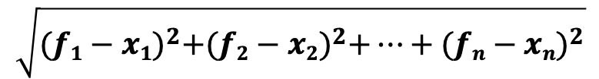
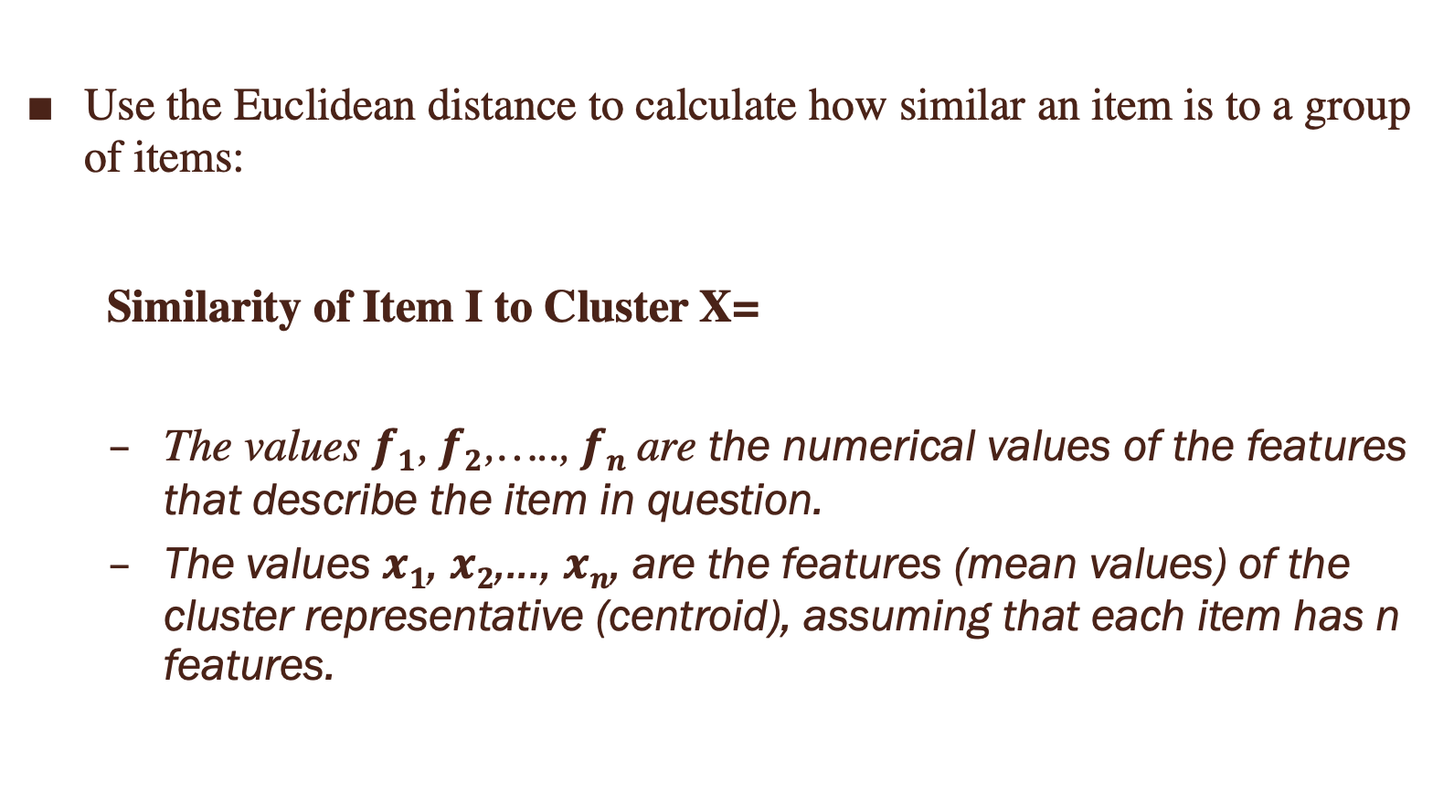
2. Inspect every other item (customer) and assign it to the cluster representative to which it is most similar.
Use the Euclidean distance to calculate how similar an item is to a group of items:
Similarity of Item I to Cluster X=
The values $f1$, $f2$,….., $fn$ are the numerical values of the features that describe the item in question.
The values $x1$, $x2$,..., $xn$, are the features (mean values) of the cluster representative (centroid), assuming that each item has n features.
$$\sqrt{{(f1−x1)}^{2}+{(f2−x2)}^{2}+…+{(fn−xn)}^{2}}$$

Slide 36
2. Inspect every other item (customer) and assign it to the cluster representative to which it is most similar.
The similarity of Customer 2 to Cluster 1 is calculated as follows:
Similarity of Item 2 to Cluster 1 = √ (3−2)²+(4−2)²
= 2.23
Here’s what the same process looks like with Cluster 2:
Similarity of Item 2 to Cluster 2 = √ (3−10)²+(4−14)²
=12.20
Comparing these results, you assign Item 2 (that is, Customer 2) to Cluster 1 because the numbers say Item 2 is more similar to Cluster 1.

Slide 37
3. Apply the same similarity analysis to every other item in the dataset.
Every time a new member joins a cluster, you must recalculate the cluster representative, following the procedure shown in Table 6-2.
The use of K-means is an iterative process.
At each iteration, the algorithm steps shown here are repeated until the clusters show no further changes.
Notes:
28.35 grams. There are 16 ounces in a pound

Slide 38
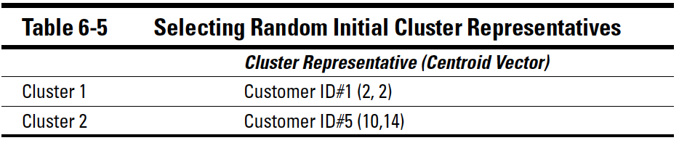
3. Apply the same similarity analysis to every other item in the dataset.
Tables 6-4 and 6-5 show these iterations and assignments of items to clusters.
At the end of Iteration 1, Cluster 1 contains Items 1, 2, and 3; Cluster 2 contains Items 4, 5, 6 and 7.
The new cluster representatives are (3.6, 4.6) for Cluster 1 and (8.2, 10.8) for Cluster 2.

Slide 39
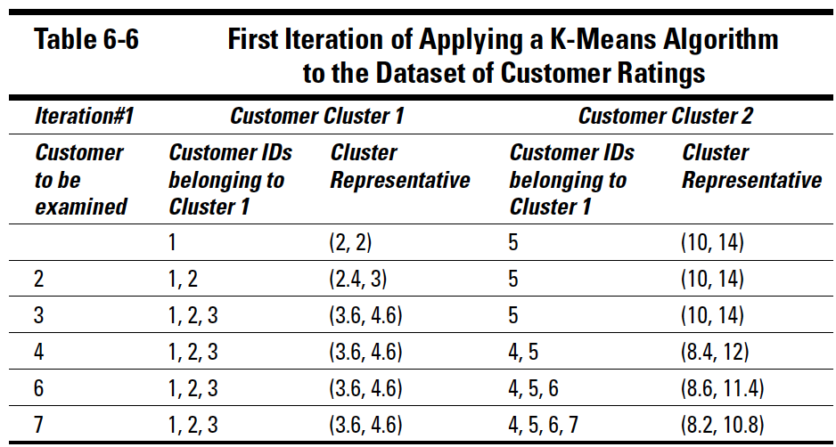
3. Apply the same similarity analysis to every other item in the dataset.
Table 6-6 depicts the results of the first iteration of K-mean algorithm.
Notice that k equals 2, so you’re looking for two clusters, which divides a set of customers into two meaningful groups.
Every customer is analysed separately and is assigned to one of the clusters on the basis of the customer’s similarity to each of the current cluster representatives.
Note that cluster representatives are updated each time a new member joins a cluster.

Slide 40
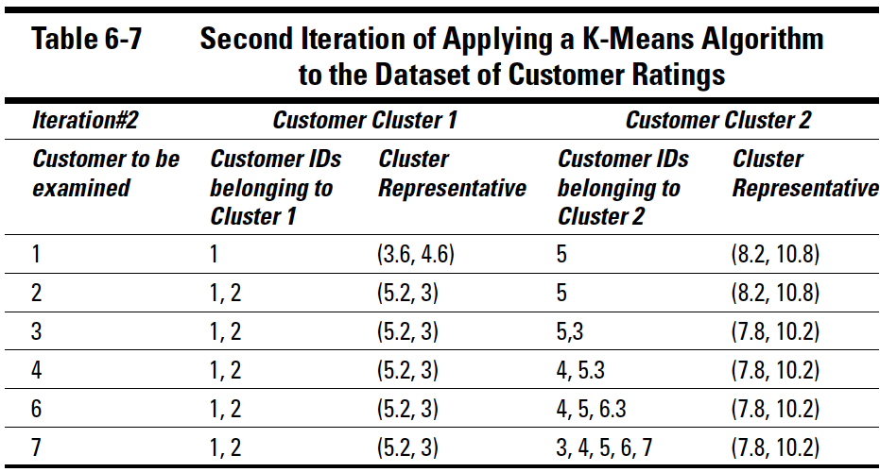
4. Iterate the dataset again, going through every element; compute the similarity between each element and its current cluster representative.
Notice that Customer 3 has moved from Cluster 1 to Cluster 2.
This is because Customer 3’s distance to the cluster representative of Cluster 2 is closer than to the cluster representative of Cluster 1.
Table 6-7 shows a second iteration of K-means algorithm on customer data.
Each customer is being re-analyzed.
Customer 2 is being assigned to Cluster 1 because Customer 2 is closer to the representative of Cluster 1 than Cluster 2.
The same scenario applies to Customer 4. Notice that a cluster representative is being recalculated (as in Table 6-3) each time a new member is assigned to a cluster.

